Slide 1

Bubble
Team 4 (Hun-Min Park, Sang-Gyun An, JongMin Jin)

Slide 2
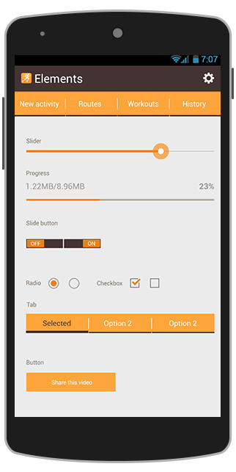
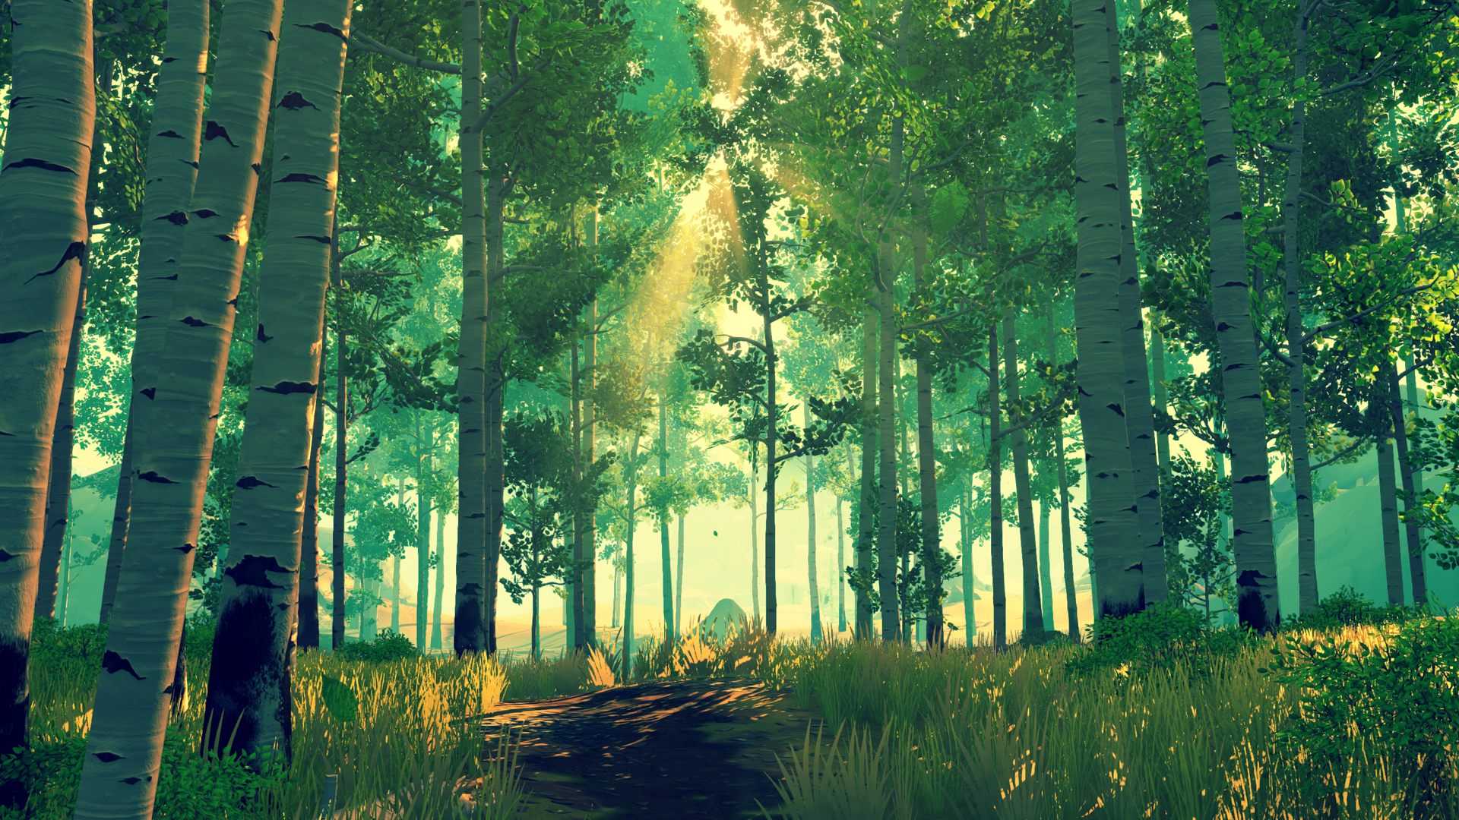



Start
Flying
Let’s blow a virtual bubble as far as you can!

Slide 3
Project schedule
Step 1
Project
Setup
Step 2
Basic graphics
&
physics
Step 3
Advanced graphics
Step 4
Alpha ver.
Step 5
Beta ver.
Presentation 1 (10/13)
Presentation 2
(11/03)
Presentation 3 (11/17)
Presentation 4
(12/01)
Final
(12/14)

Slide 4
Step 3: Advanced graphics & rough usability test
Detailed map with texture
More natural look of bubble
Natural control of bubble by blowing
Collision detection between bubble and map
Rough usability test

Slide 5
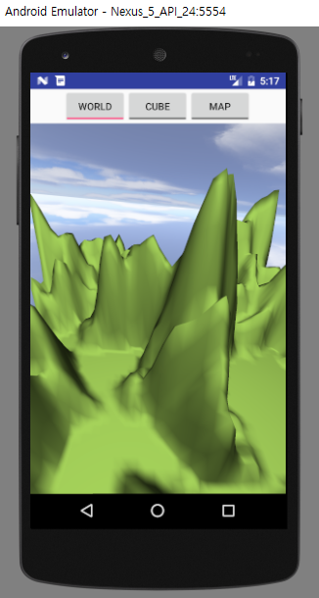
Detailed map
Make the map more realistic!
Add ‘sea’ on the specific height
Apply Texture mapping
Blinn-phong shading
Haze effect
Alpha blending

Slide 6
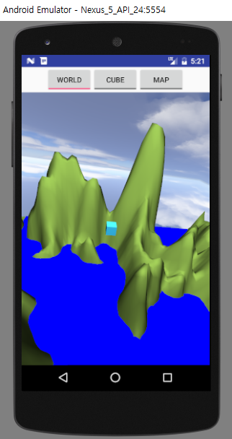
Detailed map
Make the map more realistic!
Add ‘sea’ on the specific height
Apply Texture mapping
Blinn-phong shading
Haze effect
Alpha blending

Slide 7
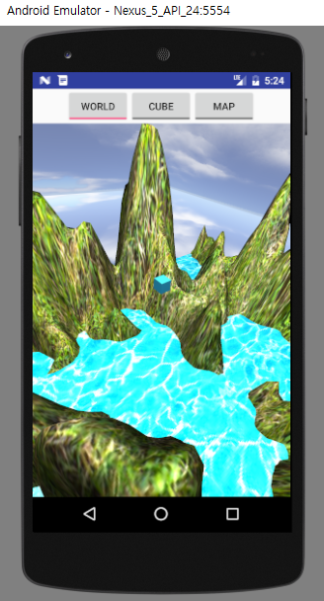
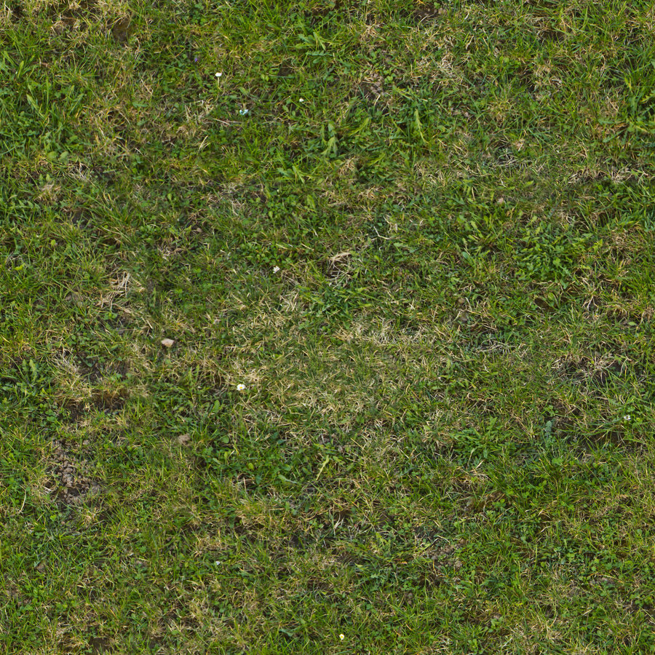
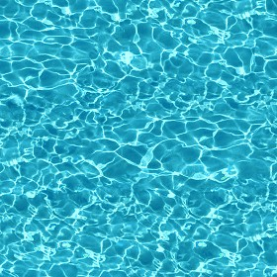
Detailed map
Make the map more realistic!
Add ‘sea’ on the specific height
Apply Texture mapping
Blinn-phong shading
Haze effect
Alpha blending

Slide 8
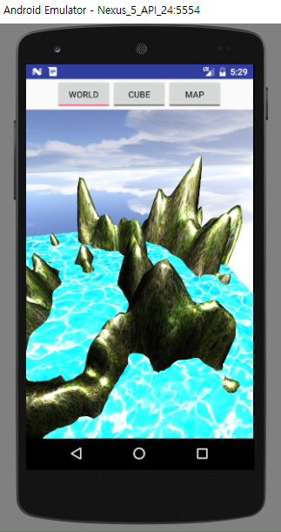
Detailed map
Make the map more realistic!
Add ‘sea’ on the specific height
Apply Texture mapping
Blinn-phong shading
Haze effect
Alpha blending

Slide 9
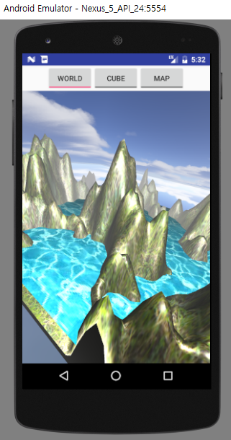
Detailed map
Make the map more realistic!
Add ‘sea’ on the specific height
Apply Texture mapping
Blinn-phong shading
Haze effect
Alpha blending
finalColor = r * originalColor + (1 - r) * fogColor

Slide 10
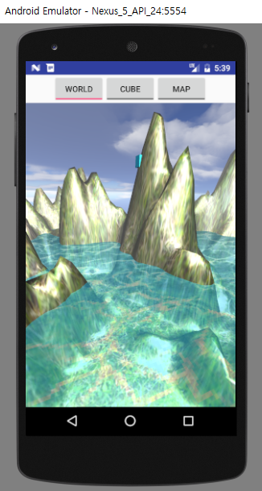
Detailed map
Make the map more realistic!
Add ‘sea’ on the specific height
Apply Texture mapping
Blinn-phong shading
Haze effect
Alpha blending
…
GLES20.glEnable(GLES20.GL_BLEND);
GLES20.glBlendFunc(GL_SRC_ALPHA, …);
mSea.draw(...)
...

Slide 11
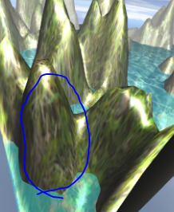
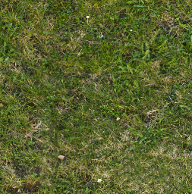
Detailed map
Challenges
Distortion of texture
Possible solutions
Tri-planar texture mapping
Use colorMap instead of texture
etc.

Slide 12
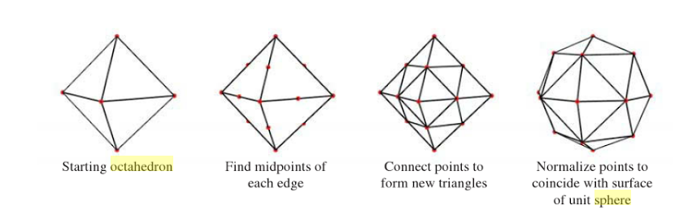
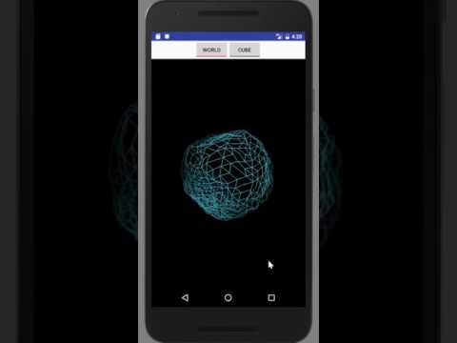
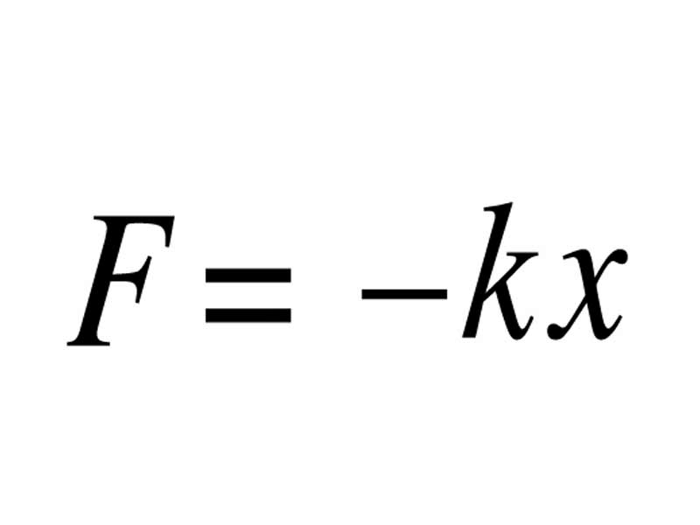

Naturally deforming bubble
Spring force → acceleration → displacement
Spring-mass model
Tuned parameters
Number of vertices
Velocity damping ratio
Spring length of rest state
Hooke’s constant
Mass of vertex

Slide 13
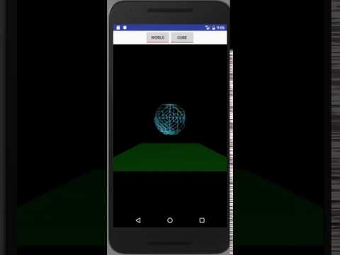
Natural move of bubble
Gravity → acceleration → displacement
Tuned parameter
Constant G
Velocity damping ratio
Mass of vertex

Slide 14
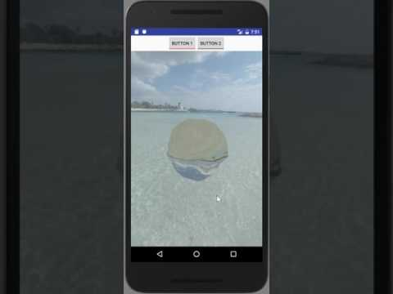
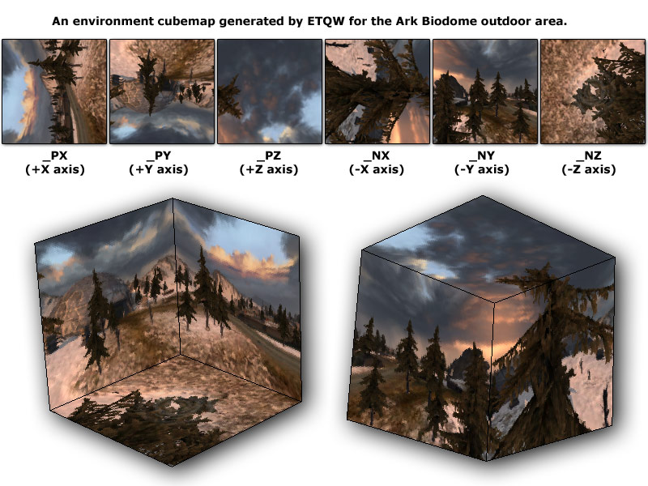
Natural look of bubble
Cube maps
Alpha blending

Slide 15
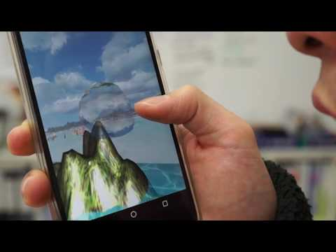
Natural control of bubble
Blowing pressure → acceleration → displacement
Force direction: camera’s view vector
Camera following the bubble

Slide 16
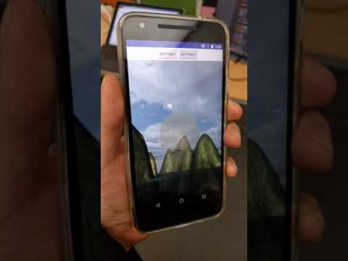
Zyro not working well with mic
Only working without mic. Why?

Slide 17
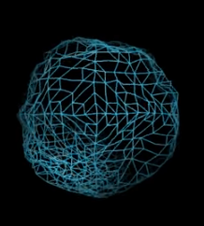
Collision detection between bubble and map
(to be done)
Collision detection in vertex level

Slide 18

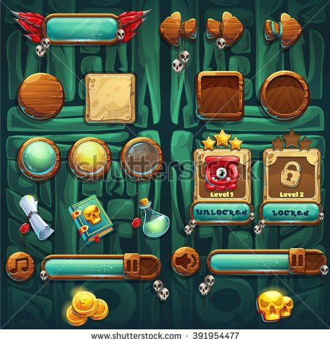
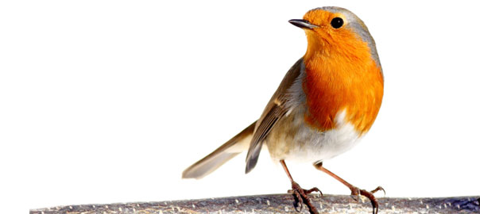
Next Step
Alpha version
Game logic
Level design
Different map
Obstacles
UI graphic
User study

Slide 19
Thank U

Slide 20
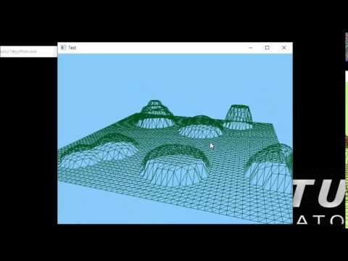
GL 3D world + Map generator
Draw a large square first.
Divide it into evenly-spaced small squares.
Pick a point P among the vertices. Let h and r height and radius of the ‘hill’.
For the points X = (x, y, z) such that |X-P| ≤ r, replace the value of y to y_new = max(h*exp(-(|X-P|/r)^2), y)
This makes a ‘hill’ on the map.
Modifying the formula gives us different kinds of hills. ex) ‘stairs’, ‘cliffs’, etc.

Slide 21
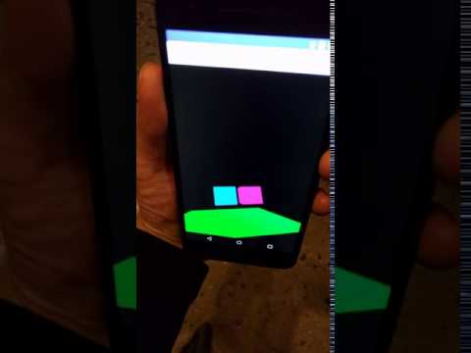
Rotate view by rotating Android device
Gyroscope sensor

Slide 22
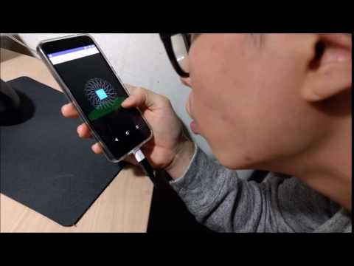
Move object by blowing
Android microphone → sound level → translation matrix

Slide 23
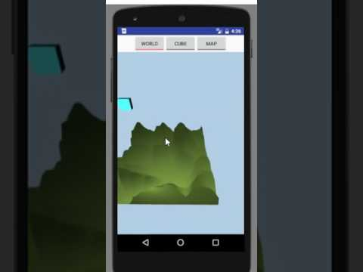
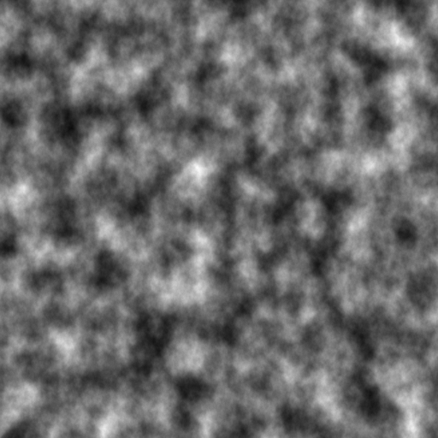
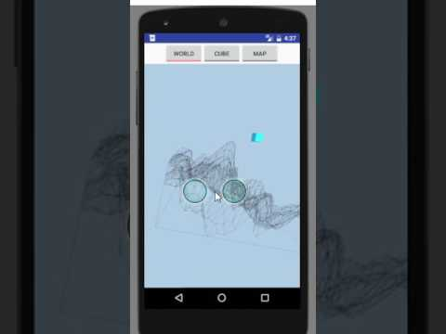
Advanced map generator
How
Perlin noise (gradient noise) * Ken Perlin. 1985. An image synthesizer. In Proceedings of the 12th annual conference on Computer graphics and interactive techniques (SIGGRAPH '85). ACM, New York, NY, USA, 287-296.
Trials
Diamond algorithm
etc.

Slide 24
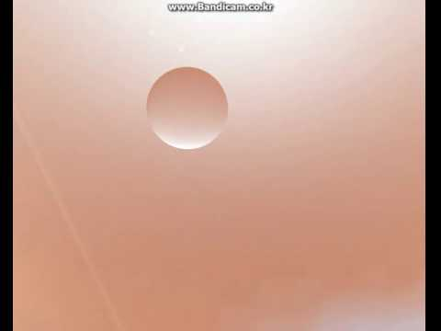
Environmental texture mapping
How
Cube maps

Slide 25
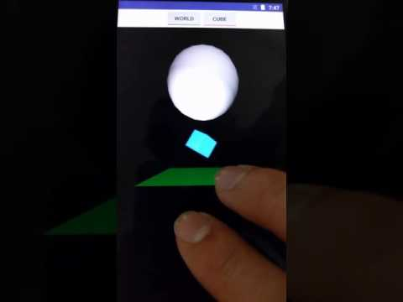

Collision detection
How
bounding box/sphere
3.4km

Slide 26
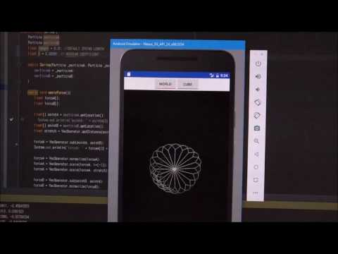
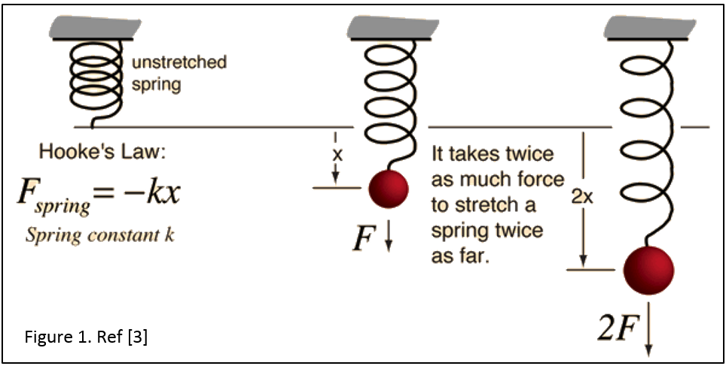
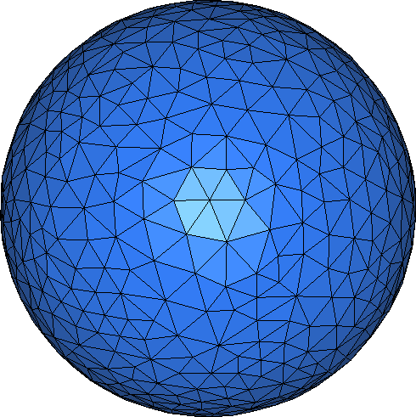
Spring-mass model
How
Spring-mass model
Future work
Dragging force to decrease oscillation.
Gravity.
Breath (wind) pressure.
etc.

